Slide 1
MEMORY HIERARCHY
Computer Organization and Assembly Language
Computer Science Department
National University of Computer and Emerging Sciences Islamabad

Slide 2
MEMORY HIERARCHY

Slide 3
MEMORY HIERARCHY
Main Memory
  Only programs and data currently needed by the processor
Auxiliary Memory
  Devices that provide backup storage
  System programs, large data files etc
  E.g. magnetic disks and tapes
Cache
  Increases the speed of processing
  Rapid rate and small size
  Compensates speed difference between main memory and processor
  Segments of programs and data currently in use

Slide 4
MEMORY HIERARCHY
Total memory capacity can be visualized as hierarchy of components
Slow to fast
High capacity to smaller capacity

Slide 5






MEMORY HIERARCHY
Main Memory
Magnetic tapes
I/O processor
Magnetic disks
Cache Memory
CPU

Slide 6
HIERARCHY LIST
Registers
L1 Cache
L2 Cache
Main memory
Disk cache
Disk
Optical
Tape

Slide 7
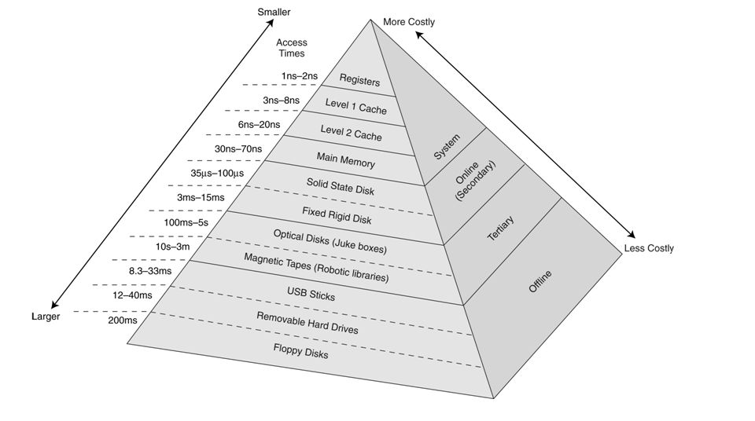
HIERARCHY LIST

Slide 8
MAIN MEMORY
Central storage unit
Large and fast memory to store programs and data during the computer operation
RAM
  Random access memory
  Volatile
  Stores programs and data that are subject to change
  Read/write memory
ROM
  Read only memory
  Non-volatile
  Stores tables of constant data that do not change

Slide 9
MAIN MEMORY
Bootstrap loader
  Startup program
  Stored in ROM
  Its function is to load the operating system
ROM and RAM chips are available in variety of sizes
  e.g. 128x8

Slide 10

RAM CHIP
7 bit address bus
8 bit data bus
Two chip selects
Read control signal
Write control signal
Chip Select 1
128x8 RAM
Chip Select 2
Read
Write
8-bit data bus
7-bit Address

Slide 11
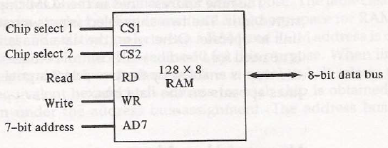
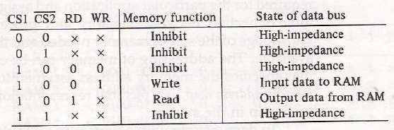
RAM CHIP (FUNCTION TABLE)

Slide 12
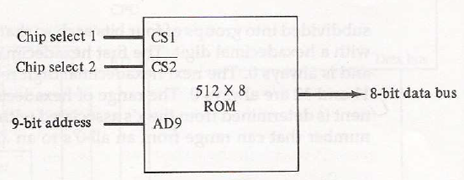
ROM CHIP

Slide 13
MEMORY CONNECTION TO CPU
Memory Capacity : 512 bytes of RAM and 512 bytes of ROM
Chips Available : 128x8 RAM
512x8 ROM
4 RAMS and 1 ROM
Each RAM receives 7 lower bits
Particular RAM chip selected is determined by lines 8 and 9
Selection between ROM and Ram is done by line 10

Slide 14
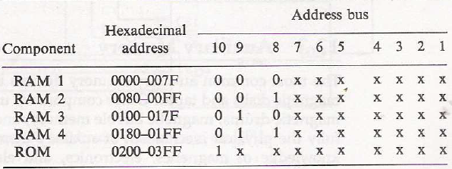
MEMORY ADDRESS MAP

Slide 15







MEMORY CONNECTION TO CPU
CPU
128x8
RAM 1
128x8
RAM 2
Address Bus
9 8 7 6 5 4 3 2 1 0
Decoder
3 2 1 0
128x8
RAM 3
128x8
RAM 4
512x8
ROM
Notes:
Address Bus Information:
Common address lines of RAM: 7 , Common Addresses: 0-127
Line#9: Selection between RAM and ROM
Line#8 & Line#7: Selection between RAM if Line#9 contains information about RAM

Slide 16
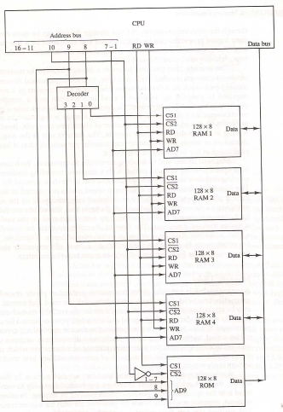
MEMORY CONNECTION TO CPU
Notes:
Address Bus Information:
Common address lines of RAM: 7 , Common Addresses: 0-127
Line#9: Selection between RAM and ROM
Line#8 & Line#7: Selection between RAM if Line#9 contains information about RAM

Slide 17
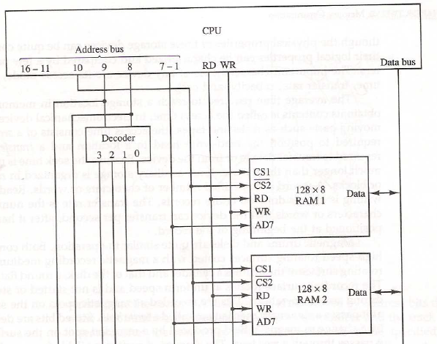
MEMORY CONNECTION TO CPU
Notes:
Address Bus Information:
Common address lines of RAM: 7 , Common Addresses: 0-127
Line#9: Selection between RAM and ROM
Line#8 & Line#7: Selection between RAM if Line#9 contains information about RAM

Slide 18
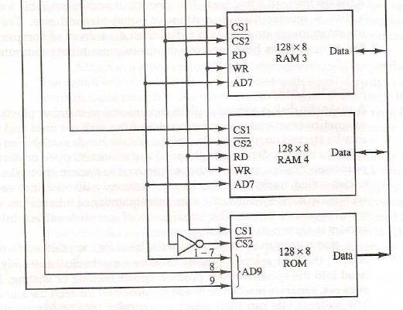
MEMORY CONNECTION TO CPU
Notes:
Address Bus Information:
Common address lines of RAM: 7 , Common Addresses: 0-127
Line#9: Selection between RAM and ROM
Line#8 & Line#7: Selection between RAM if Line#9 contains information about RAM

Slide 19
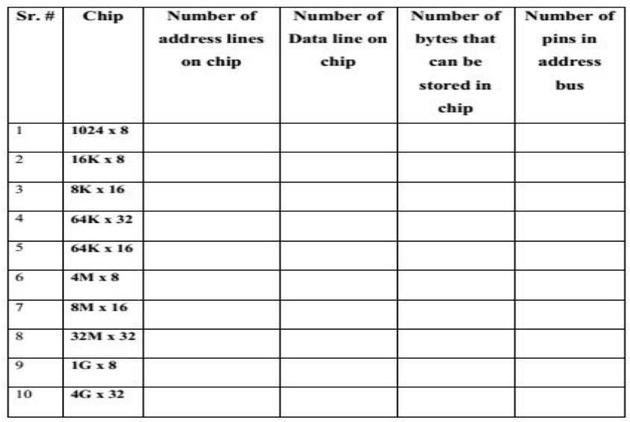
MEMORY CONNECTION TO CPU
Notes:
Address Bus Information:
Common address lines of RAM: 7 , Common Addresses: 0-127
Line#9: Selection between RAM and ROM
Line#8 & Line#7: Selection between RAM if Line#9 contains information about RAM

Slide 20
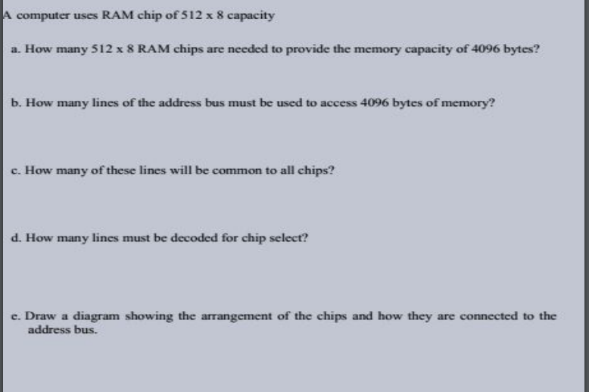
Notes:
Address Bus Information:
Common address lines of RAM: 7 , Common Addresses: 0-127
Line#9: Selection between RAM and ROM
Line#8 & Line#7: Selection between RAM if Line#9 contains information about RAM

Slide 21
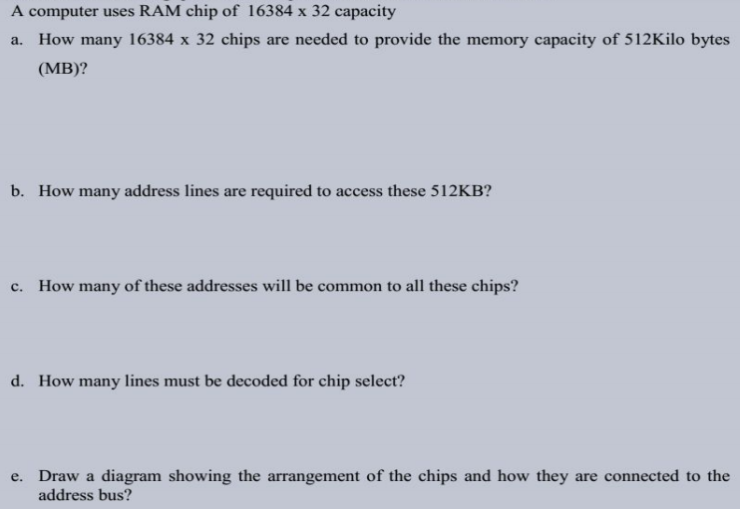
Notes:
Address Bus Information:
Common address lines of RAM: 7 , Common Addresses: 0-127
Line#9: Selection between RAM and ROM
Line#8 & Line#7: Selection between RAM if Line#9 contains information about RAM

Slide 22
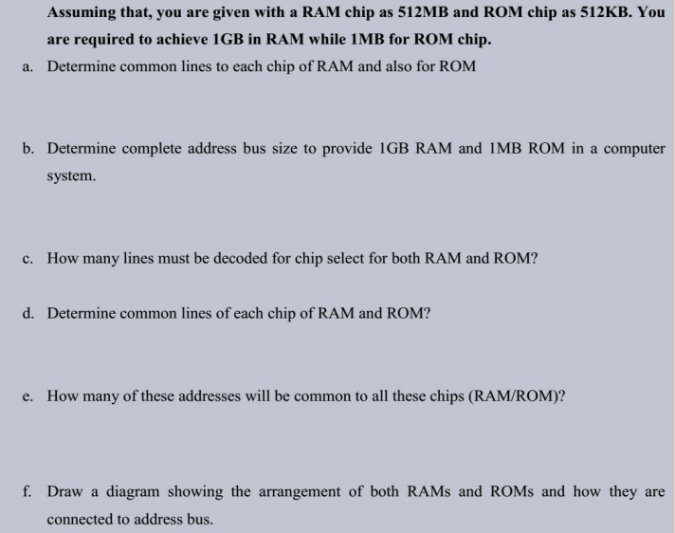
Notes:
Address Bus Information:
Common address lines of RAM: 7 , Common Addresses: 0-127
Line#9: Selection between RAM and ROM
Line#8 & Line#7: Selection between RAM if Line#9 contains information about RAM

Slide 23
MEMORY
Characteristics
  Access mode
  Access time
  Transfer rate
  Capacity
  Cost

Slide 24
ACCESS MODE
Sequential
  Start at the beginning and read through in order
  Access time depends on location of data and previous location
  e.g. tape
Direct
  Individual blocks have unique address
  Access is by jumping to vicinity plus sequential search
  Access time depends on location and previous location
  e.g. disk
Notes:
sequential access means that a group of elements (e.g. data in a memory array or a disk file or on a tape) is accessed in a predetermined, ordered sequence. Sequential access is sometimes the only way of accessing the data, for example if it is on a tape
Direct access-Key mechanism

Slide 25
ACCESS MODE
Random
  Individual addresses identify locations exactly
  Access time is independent of location or previous access
  e.g. RAM
Associative
  Data is located by a comparison with contents of a portion of the store
  Access time is independent of location or previous access
  e.g. cache

Slide 26
ACCESS TIME
The average time to reach a storage location in memory and obtain its content
Access Time = seek time + transfer time
Seek Time
  Time required to position the read/write head to a location
Transfer Time
  Time required to transfer data to or from the device

Slide 27
TRANSFER RATE
Word or bytes transferred at one time
For internal memory it is usually governed by data bus width

Slide 28
LOCALITY OF REFERENCE
The references to memory at any given interval of time tend to be confined with in a few localized areas in memory
If the active portions of the program and data are placed in a fast small memory, the efficiency can be increased
Such small fast memory is referred to as cache memory

Slide 29

CACHE
Small amount of fast memory
Sits between normal main memory and CPU
May be located on CPU chip or module
Faster than main memory by a factor of 5 to 10

Slide 30
CACHE OPERATION - OVERVIEW
CPU requests contents of memory location
Check cache for this data
If present, get from cache (fast)
If not present, read required block from main memory to cache
Then deliver from cache to CPU
Cache includes tags to identify which block of main memory is in each cache slot

Slide 31
CACHE PERFORMANCE
Hit ratio
  When CPU refers to memory and finds the word in cache, it is said to produce a hit
  If not found, it is called a miss
  Hit Ratio = Number of hits / Total CPU references to memory

Slide 32
REFERENCES
Computer System Architecture by Morris Mano – Chapter 12
Computer Organization and Architecture
by William Stallings – Chapter 4

